Slide 1
Small Worlds

Slide 2
The small world phenomenon
Two strangers meet; what are the odds that they would have an acquaintance in common?
  How about being two (3, 4, 5, .... k) steps away from one another? (Pool and Kochen 1978)
  Infinitesimally small if connections formed at random
    Especially given the order of the underlying (world) graph:
7,609,397,962
  Not that small in real world networks
    Why?
    Does it characterize other (non-social) networks?
    How does the SW property arise?

Slide 3
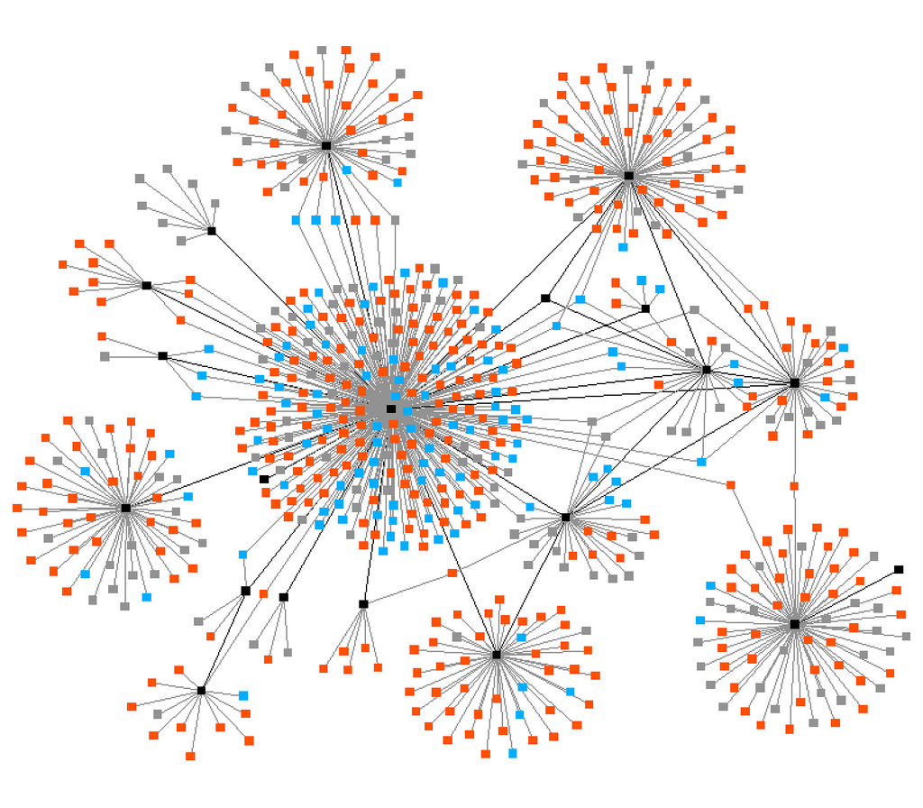
The small world phenomenon
A given (large-scale) network is a "small world" if:
  The order of the graph (N) is large
  The graph is sparse (any node is on average connected to only a relatively small number of other nodes k)
    k ~ 10² in human social networks (Pool and Kochen 1978)
  Graph is decentralized (max degree is much smaller than the order of the graph N)
  The network exhibits clustering (friends of friends tend to be friends)

Slide 4
The small world phenomenon
Average degree:
  How big is the typical person’s social network?
  150? 300? 600?
How many people can the average person reach
  in 2 hops: k²
  in 3 hops: k³
  in l hops: k^{l}

Slide 5
The small world phenomenon
If k is large, for small values of l the number of others a person can reach is very large
  Ex, k= 400, k²=160,000, k³ = 64,000,000, k⁴ = 25,600,000,000
Growth mechanism: random tie formation
  But is a random network a social network?
    Degree distribution is normal
    No clustering (few triangles)

Slide 6

The small world phenomenon
Classic study by Travers and Milgram (1969)
Target (Boston stockbroker)
  296 participants ("starting persons")
  196 from Nebraska
    100 Stockbrokers
    96 Random
  100 from Boston
  217 forwarded packet so get to target person
  453 Intermediaries enlisted by the participants

Slide 7

The small world phenomenon
Target (Boston stockbroker)
  296 participants ("starting persons")
  196 from Nebraska
    100 Stockbrokers
    96 Random
  100 from Boston
  217 forwarded packet so get to target person
  453 Intermediaries enlisted by the participants
64 completed chains (29%)
    Mean path length: 5.2

Slide 8

The small world phenomenon
Target (Boston stockbroker)
  296 participants ("starting persons")
  196 from Nebraska
    100 Stockbrokers
    96 Random
  100 from Boston
  217 forwarded packet so get to target person
  453 Intermediaries enlisted by the participants
232 incomplete chains (71%)
  Mean path length: 2.6

Slide 9
The small world phenomenon
Out of the 64 completed chains 26 people made the final link
16 (25%) reached the target via a single neighbor: "Mr. G."
  Another accounted for 10
  Another for 5
  The top three account for 48% of completions
86% of “starters” sent the letter to friends and acquaintances
  14% send it to relatives
  age, gender, SES homophily in Intermediary choice

Slide 10
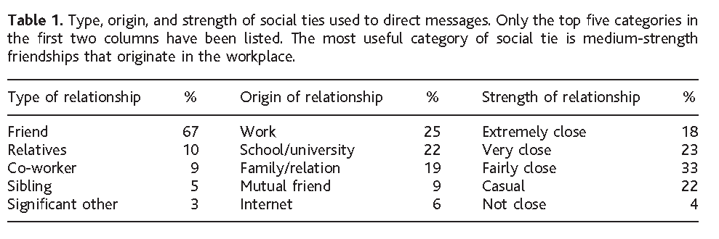
The small world phenomenon
Dodds, Muhamad and Watts (2003) Replication of Milgram
  Internet based social experiment
    18 target persons from 13 countries randomly allocated
    98,847 participants registered, 25% initiated a chain
    61,168 total participants from 166 countries (including intermediaries)

Slide 11
The small world phenomenon
Dodds, Muhamad and Watts (2003) Replication of Milgram
  More than half from North America
    Middle Class
    Professional, College Educated
    Largely Christian

Slide 12
The small world phenomenon
Dodds, Muhamad and Watts (2003) Replication of Milgram
  Strong preference for:
    Friends as role relations (rather than kin or co-workers)
    Ties embedded in work and school affiliations
    Ties of Intermediate strength (closeness)
    Same-gender ties

Slide 13
The small world phenomenon
Dodds, Muhamad and Watts (2003) Replication of Milgram
  Most effective chains more likely to feature:
    Professional ties (in contrast to friend and kin) as role relations
    Work or higher education ties as foci
    Either casual or “not close” ties in terms of strength
      Why this pattern?

Slide 14
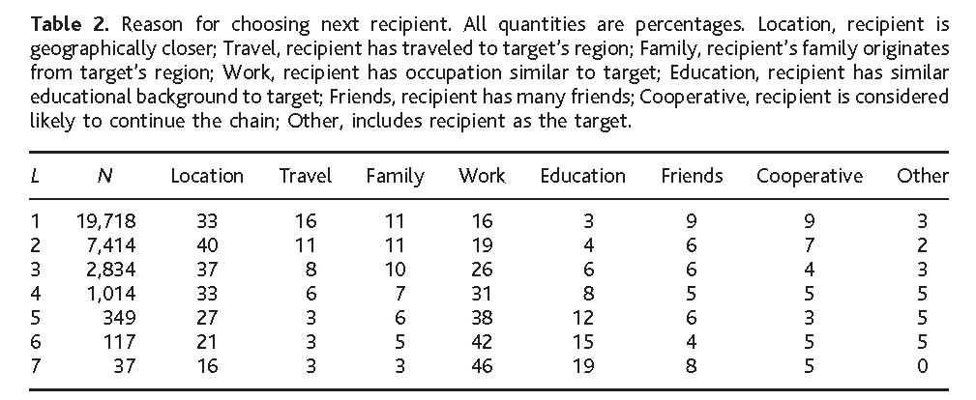
The small world phenomenon
Dodds, Muhamad and Watts (2003) Replication of Milgram
  Geographic proximity and similarity of occupation were the primary search heuristics
    Number of friends ("hub heuristic") almost never used
    Proximity declines and homophily increases in importance with chain length

Slide 15
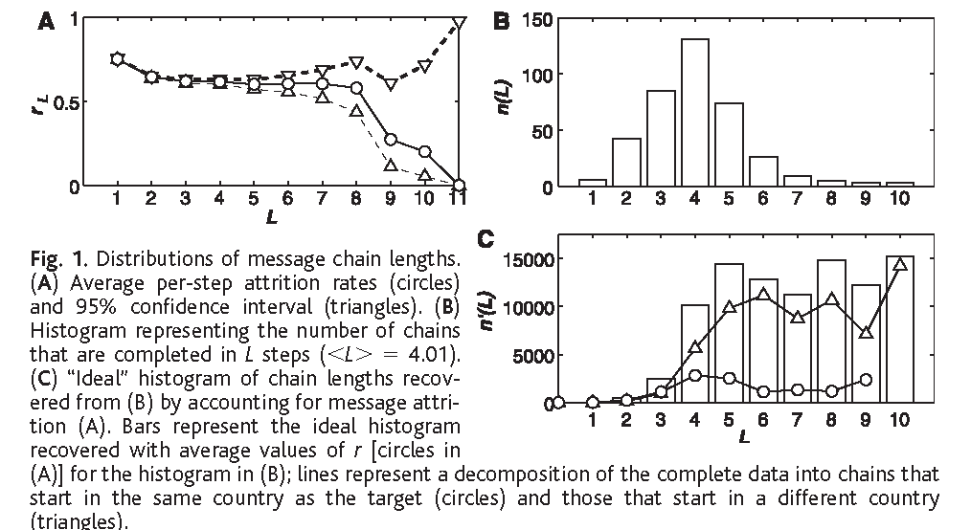
The small world phenomenon
384 completed chains (out 24,163); Average (L): 4.05
Corrected for attrition the median chain length is between 5 and 7

Slide 16
The small world phenomenon
We may differentiate between the two facets of the SW phenomenon as providing answers to two different empirical questions:
  SW1: Why should there exist short chains of acquaintances linking together arbitrary pairs of strangers?
    This is the Small World Problem
  SW2: Given SW1, why should an agent be able to find short chains of acquaintances that links her to a random stranger?
    This is the Search Problem
The problem: not all small world networks are searchable
  Kleinberg (2000) showed that searchable SW structures exist for only a very limited range of random connectivity
  Too much randomness and navigability is lost

Slide 17
The small world phenomenon
We may differentiate between the two facets of the SW phenomenon as providing answers to two different empirical questions:
  SW1: Why should there exist short chains of acquaintances linking together arbitrary pairs of strangers?
    This is the Small World Problem
  SW2: Given SW1, why should an agent be able to find short chains of acquaintances that links her to a random stranger?
    This is the Search Problem
The two issues are distinct because SW1 can hold without SW2 being true
  Real human social networks are both “small” and “searchable” different theories apply:
    Structural
    Social psychological/heuristics

Slide 18
The small world phenomenon
SW1 |  | SW2
Contagion/Spread/ Transmission/Diffusion (unguided) | Process | Directed Search (guided)
Small World Structure (Big C plus Small L) | Structure | Searchable Network Structure
Agent-Level Representation of Whole Network Structure ("It's a small world!") | Cognition | Agent-Level Representation of Local Search Paths/Search Heuristics

Slide 19
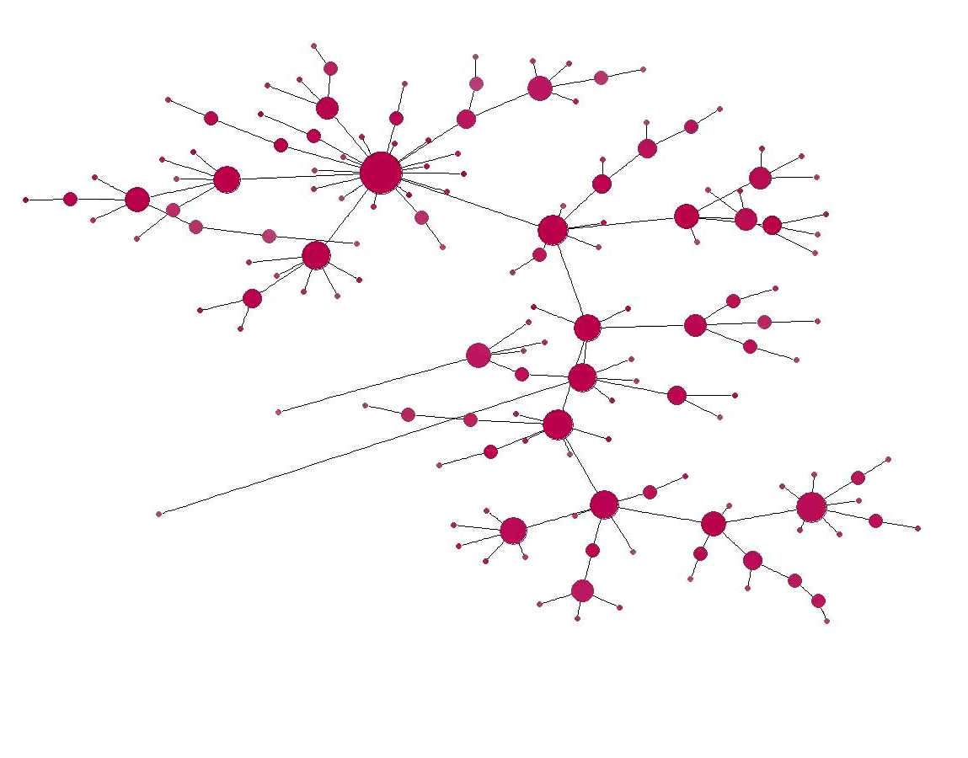
The small world phenomenon
What generates a small world?
  The Barabasi-Albert Model
    Incoming vertices connect to existing with ones with p ~ k(i)
      Where k(i) is i’s degree
  Generates: scale-free degree distribution (80-20, power law distribution)
  Small World, small diameter
    WHY? Hubs
  But…
    low clustering coefficient

Slide 20
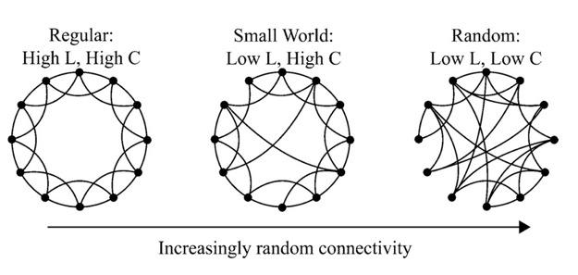
The Watts and Strogatz Model
p - randomness parameter (proportion of links that are allowed to be non-local)
G = (N, E) N vertices, E edges
K = N. of neighbors assigned to each vertex
L(p) = Average path length between two vertices
C(p) = Average clustering coefficient

Slide 21
The Watts and Strogatz Model
p = 0 (regular lattice)
  L ~ n/2k >> 1
  C ~ 3/4
  highly clustered, large world, L grows linearly with n

Slide 22
The Watts and Strogatz Model
p = 1 (random graph)
  L_{random} ~ ln(n)/ln(k)
  C_{random}~ k/n
  low clustering, small worlds, L grows logarithmically with n

Slide 23
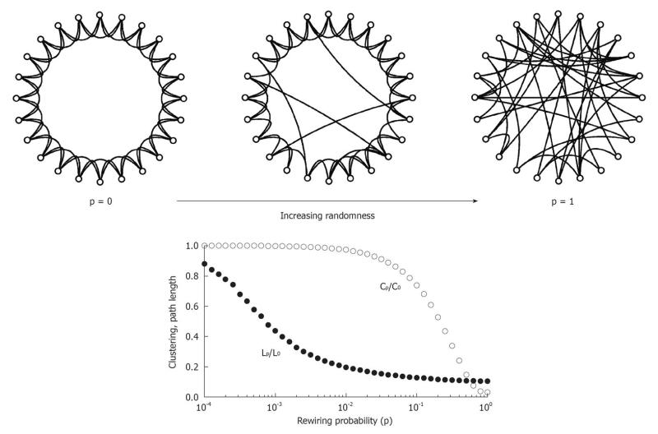
The Watts and Strogatz Model- Shortcuts
Random rewiring --> shortcuts
high nonlinear effect on L
only a linear effect on C
Only need a small fraction of short cuts
Range of p where L(p) is small world like and C(p) is large (like in real social networks)
Implications for diffusion?

Slide 24
The small world phenomenon
Why are real human social networks (seemingly) searchable?
  Watts, Dodds and Newman (2002) propose a model in which organization around nested groups (communities) is key:
    Individuals interpret the world as a set of (nested) groups
    They bottom out at a (cognitively) manageable group size
At the cognitive level individuals have two kinds of (partial) information:
  Social (group) distance (global but not equivalent to graph-theoretic distance)
    Each agent knows = his own and his neighbor's (plus target's) position in the group structure
    Otherwise ignorant of social distance between herself and others
    Each member i of a message chain forwards the message to the neighbor j who is closest to the target t in terms of social distance in the nested group hierarchy

Slide 25
The small world phenomenon
Why are real human social networks (seemingly) searchable?
  Watts, Dodds and Newman (2002) propose a model in which organization around nested groups (communities) is key:
    Individuals interpret the world as a set of (nested) groups
    They bottom out at a (cognitively) manageable group size
Research on the search strategies used in natural contexts lead to a simple heuristic used to construct a path to a random person
  Use homophily on certain characteristics as a proxy for graph-theoretic distance between target and contact (proximity strategy)
Another useful heuristic
  Use characteristics associated with connectivity (e.g. high status characteristics) to select a contact (hub strategy)

Slide 26
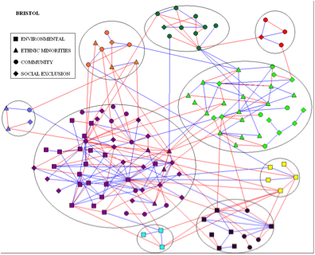
The small world phenomenon
What generates a small world?
  The “Social Circles” model
    informal networks usually formed on the basis of some common interest
    “Party rule”: “Do you know X?”
      Search for common friends
      High degree hubs within a circle
    Overlapping via
      bridges
      hubs that are in multiple groups

Slide 27
The small world phenomenon
Killworth and Bernard's (1979) "Reversal Small World" Experiment
  Useful for studying natural search strategies
    Instead of multiple starters and one target, participants are presented with a (long, more than a thousand) list of targets
      Each target had a different mix of socio-demographic characteristics (gender, race, occupation, etc.)
      Participants are asked to name the contact that they would use as the first link in trying to reach that particular target
      Participants reported contact's gender, relationship to self, reason for selection
    This is a kind of “search name generator”

Slide 28
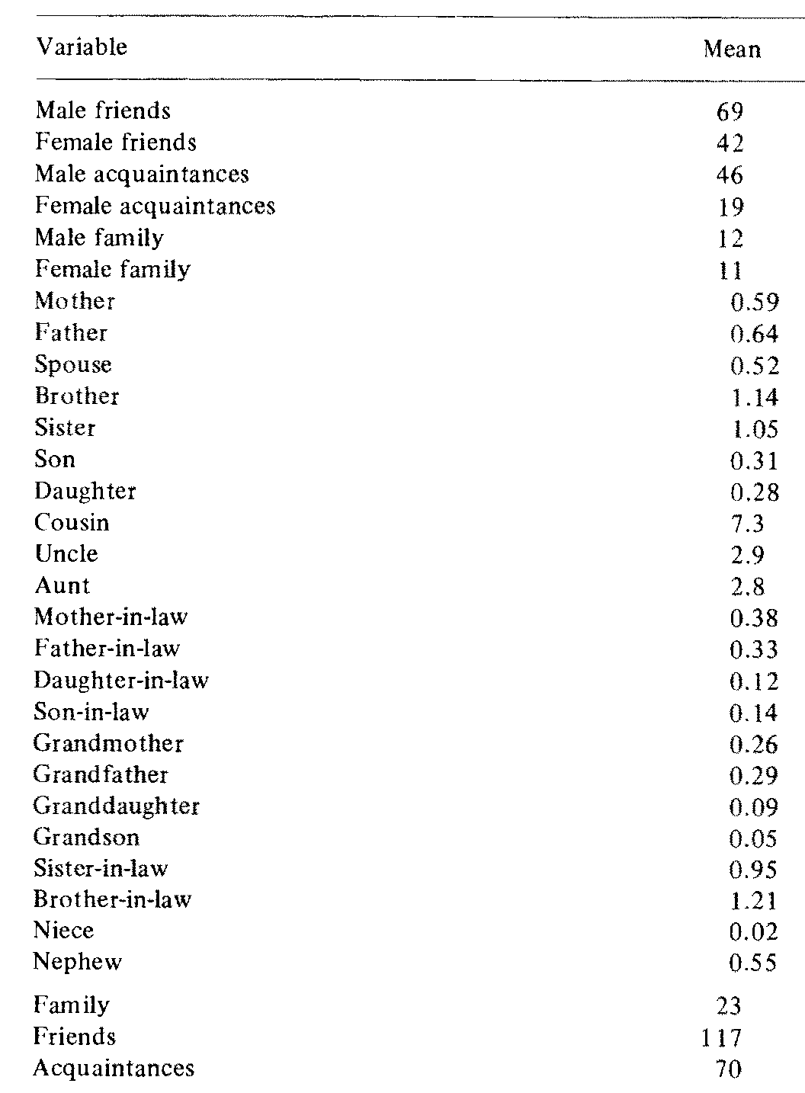
The small world phenomenon
Persons choose from three main category of contacts:
  Friends
  Acquaintances
  Family
82% of contacts were non-kin
Males more likely to be chosen
  Homophily by gender

Slide 29
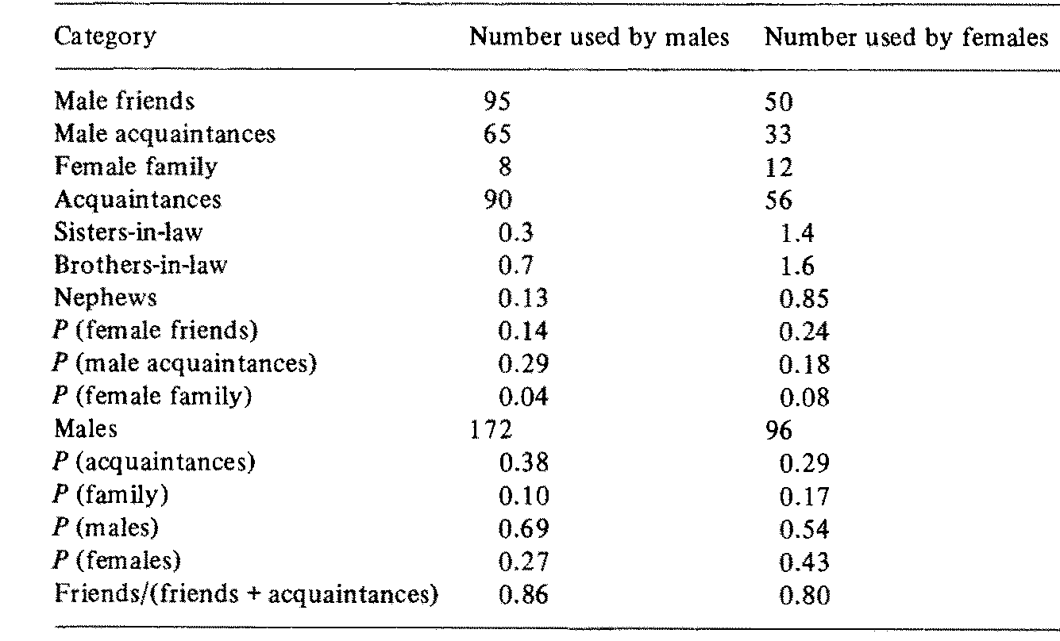
The small world phenomenon
Men displayed stronger same gender bias
  Were more also more likely to use acquaintances
Women more likely to rely on kin

